Slide 1
YOUR CRYPTO POCKETS
Your first crypto
purchase on Kraken
A beginner walkthrough
Website + Apple Pay / Google Pay
Independent tutorial / 6 October 2026
01 / 19
Notes:
Today we are walking through a first crypto purchase on Kraken. Bitcoin is our example. You can follow the same buying process for XRP, Ethereum or Solana if they are available in your account. This is a practical tutorial, not a recommendation to buy.
Sources (checked 6 October 2026):
https://www.kraken.com/buy

Slide 2
ACCOUNT SETUP
Before you begin
Go directly to kraken.com.
Create an account or sign in.
Complete identity verification.
Enable sign-in two-factor authentication.
Use the standard Kraken interface for this tutorial.
02 / 19
Notes:
Use Kraken’s official website. Register using your actual country of residence and complete the verification prompts. Protect your sign-in with two-factor authentication. We are using standard Kraken rather than Kraken Pro. Never show passwords, identity documents or authentication codes in a recording.
Sources (checked 6 October 2026):
https://www.kraken.com/buy
https://support.kraken.com/articles/360046777031-the-kraken-app

Slide 3
CHOOSE YOUR ROUTE
Two ways to pay
Bank transfer
Deposit cash first, then buy crypto.
Apple Pay or Google Pay
Pay directly when buying crypto.
Digital wallets: app supported, website availability varies.
03 / 19
Notes:
The bank route has two parts: deposit money and then buy. With a digital wallet, payment and purchase happen together. You do not need to top up a cash balance first. Apple Pay and Google Pay are available in the Kraken app. Some website accounts also show these options.
Sources (checked 6 October 2026):
https://support.kraken.com/articles/360049073651-how-do-i-deposit-my-local-currency-to-kraken-
https://support.kraken.com/au/articles/4405883992724-digital-wallet-purchases

Slide 4
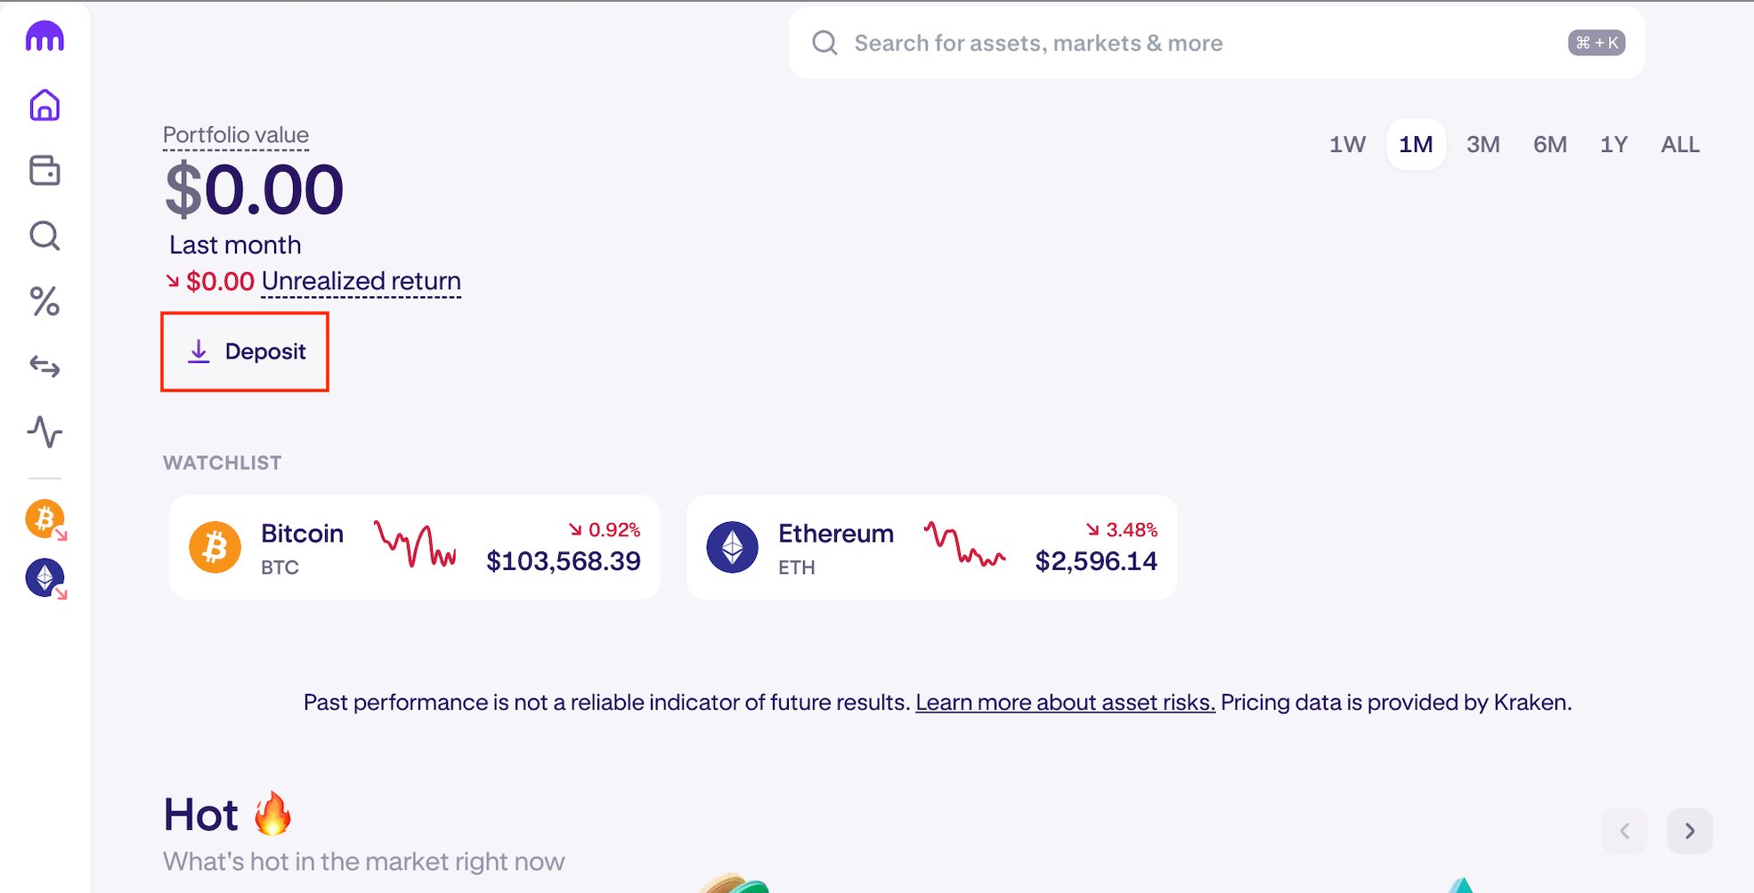
BANK TRANSFER / WEBSITE
1. The deposit page
Sign in to Kraken.
Click Deposit.
Or open Transfer, then Deposit.
Look for Deposit in your own account.
Kraken help example. Values and layout may differ.
04 / 19
Notes:
For the bank route, start at Deposit. The screenshot is Kraken’s help example, so its balances and layout may differ from yours. Use the Deposit button or find Deposit under Transfer.
Sources (checked 6 October 2026):
https://support.kraken.com/articles/360049073651-how-do-i-deposit-my-local-currency-to-kraken-
Screenshot: deposit.png from Kraken official support. Example values only.

Slide 5
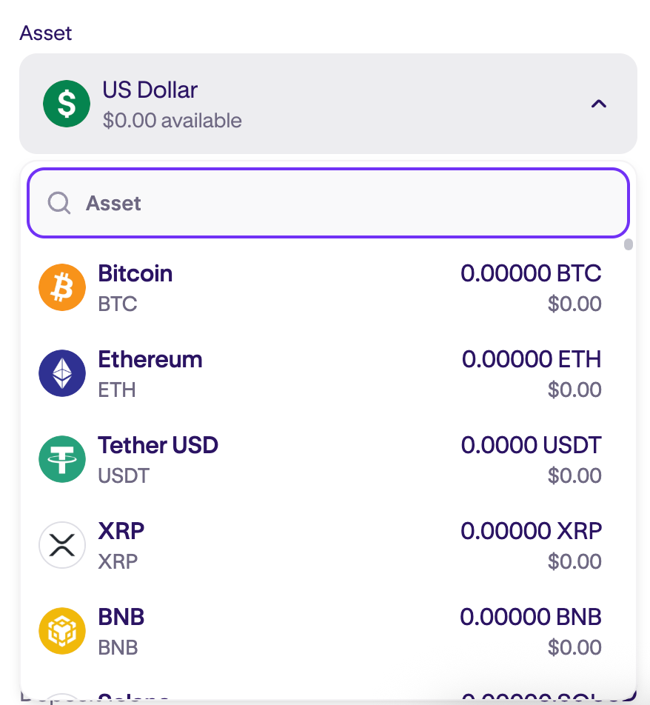
BANK TRANSFER / WEBSITE
2. Your deposit currency
Select a cash currency.
Use one your account supports.
Check conversion costs with your bank.
NZ viewers: do not assume NZD or NZ bank funding is available.
Kraken help example. Values and layout may differ.
05 / 19
Notes:
Choose the cash currency you intend to send. USD here is only an example. For New Zealand viewers, check the currencies and funding routes shown in your account. Your bank may need to convert NZ dollars. Confirm the exchange rate and fees before sending.
Sources (checked 6 October 2026):
https://support.kraken.com/articles/360049073651-how-do-i-deposit-my-local-currency-to-kraken-
https://support.kraken.com/articles/360000381846-cash-deposit-options-fees-minimums-and-processing-times-
Screenshot: currency.png from Kraken official support. Example values only.

Slide 6
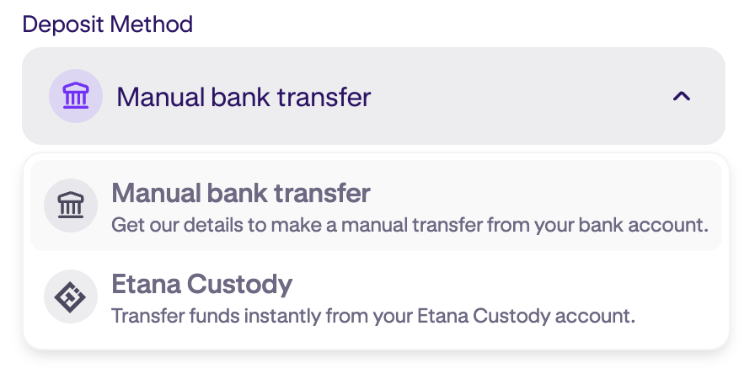
BANK TRANSFER / WEBSITE
3. The bank transfer method
Choose Manual bank transfer.
Select an available funding provider.
Read its fees, minimum and arrival time.
Options depend on your account and location.
Kraken help example. Values and layout may differ.
06 / 19
Notes:
Choose an available bank transfer route and funding provider. Read the requirements before you proceed. Check the minimum deposit, transfer fees and expected processing time. Do not select a domestic route for which you are not eligible.
Sources (checked 6 October 2026):
https://support.kraken.com/articles/360049073651-how-do-i-deposit-my-local-currency-to-kraken-
https://support.kraken.com/articles/360000381846-cash-deposit-options-fees-minimums-and-processing-times-
Screenshot: method.png from Kraken official support. Example values only.

Slide 7
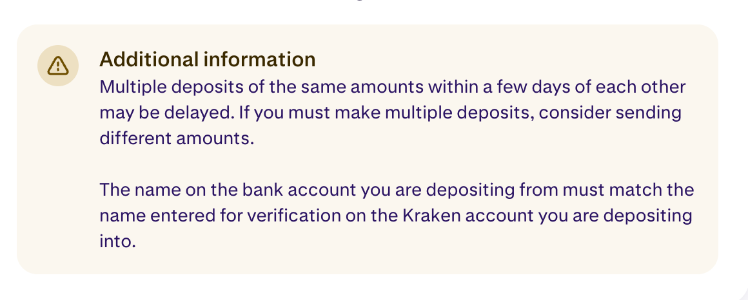
BANK TRANSFER / WEBSITE
4. The transfer from your bank
Copy the current bank details.
Include the required reference.
Send the exact supported currency.
Use a bank account in your name.
Use details from YOUR account. Never copy a tutorial’s bank details.
Kraken help example. Values and layout may differ.
07 / 19
Notes:
Open your banking service and use the instructions displayed inside your Kraken account. Include the required reference exactly. Use the current deposit instructions in your account. Never use bank details copied from a tutorial. Check the beneficiary, currency and amount before authorising your bank transfer.
Sources (checked 6 October 2026):
https://support.kraken.com/articles/360049073651-how-do-i-deposit-my-local-currency-to-kraken-
https://support.kraken.com/articles/360000381846-cash-deposit-options-fees-minimums-and-processing-times-
Screenshot: details.png from Kraken official support. Example values only.

Slide 8
BANK TRANSFER / WEBSITE
5. The cash balance
Wait for the deposit to arrive.
Check your cash balance in Portfolio.
Then continue to Buy.
A cash deposit does not automatically buy cryptocurrency.
08 / 19
Notes:
Return to Kraken and wait until the cash appears in your balance. A pending transfer is not yet available to spend. Keep your bank receipt. If the stated arrival time passes, contact official support with the transfer information.
Sources (checked 6 October 2026):
https://support.kraken.com/articles/360000381846-cash-deposit-options-fees-minimums-and-processing-times-
https://support.kraken.com/articles/360049073651-how-do-i-deposit-my-local-currency-to-kraken-

Slide 9
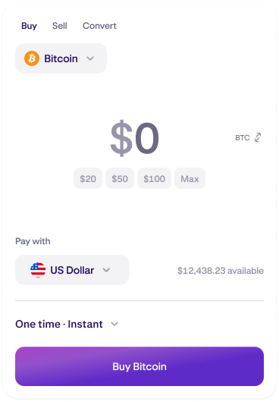
BUYING / WEBSITE
6. The cryptocurrency
Click Buy.
Click the selected asset’s name.
Search Bitcoin and select BTC.
Other examples: XRP, Ethereum (ETH), Solana (SOL).
Kraken help example. Values and layout may differ.
09 / 19
Notes:
Click Buy and choose the asset. Bitcoin is the example here. Check the full name and ticker before selecting your cryptocurrency. Availability can differ by location.
Sources (checked 6 October 2026):
https://support.kraken.com/articles/360051144472-buying-crypto-on-kraken
https://support.kraken.com/articles/360046777031-the-kraken-app
Screenshot: buy.png from Kraken official support. Example values only.

Slide 10
BUYING / WEBSITE
7. The amount and payment
Enter how much cash to spend.
Choose your cash balance in Pay With.
Select One time for a single purchase.
Enter your amount before clicking Buy Bitcoin.
Kraken website / One time shown. Example values.
10 / 19
Notes:
Enter your spending amount in the amount field. Choose the funded cash balance under Pay with. Check that the frequency is One time. The Kraken support screenshot shows the entry screen before an amount is entered; zero is a placeholder, not a purchase amount. Click Buy plus the asset name to proceed to the quote.
Official sources checked 6 October 2026:
https://support.kraken.com/articles/360051144472-buying-crypto-on-kraken

Slide 11
BUYING / WEBSITE
8. The purchase quote
Click Buy + the asset name.
Read the confirmation screen.
Check crypto quantity, price and fees.
Check the total cash charge.
Stop here if any detail looks wrong.
11 / 19
Notes:
The next screen lets you review the order. Compare the total cash charge with the crypto quantity you will receive. Look at the price and fees. The quote can change as prices move. You can stop before confirmation if you do not want to proceed.
Sources (checked 6 October 2026):
https://support.kraken.com/articles/360051144472-buying-crypto-on-kraken

Slide 12
BUYING / WEBSITE
9. The final confirmation
Click Confirm when ready.
Complete any payment approval.
Wait for the success message.
Kraken says initiated purchases are final and non-refundable.
12 / 19
Notes:
Confirm only after checking the order. A card payment may require an additional security approval from your bank. Let the transaction finish rather than refreshing or submitting a second purchase.
Sources (checked 6 October 2026):
https://support.kraken.com/articles/360051144472-buying-crypto-on-kraken
https://support.kraken.com/au/articles/4405883992724-digital-wallet-purchases

Slide 13
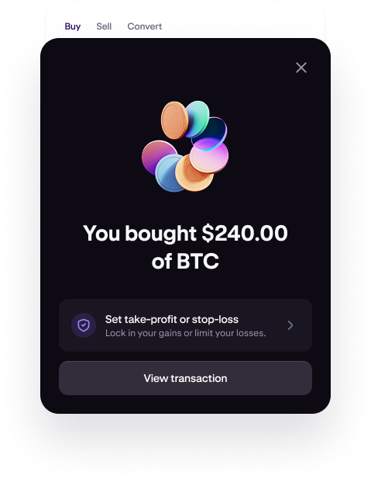
PURCHASE COMPLETE
10. Your crypto balance
Check the success message.
Open Portfolio to view the asset.
Keep your transaction record.
Your crypto remains on the exchange until you withdraw it.
Kraken help example. Values and layout may differ.
13 / 19
Notes:
Check that Kraken reports success, then look for the asset in your portfolio and keep the transaction record. A balance on Kraken is exchange custody. Moving it to a personal wallet is a separate process requiring the correct network and address.
Sources (checked 6 October 2026):
https://support.kraken.com/articles/360051144472-buying-crypto-on-kraken
https://support.kraken.com/articles/360046777031-the-kraken-app
Screenshot: success.png from Kraken official support. Example values only.

Slide 14
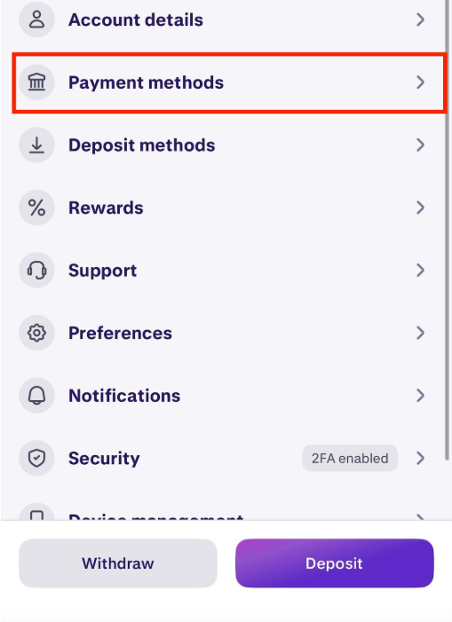
ALTERNATIVE / DIGITAL WALLET
A. Apple Pay / Google Pay setup
Add your card to Apple Pay / Google Pay.
In the Kraken app: open Account,
then Payment methods.
Select Apple Pay or Google Pay.
Once connected, your wallet appears in Pay with.
Kraken help example. Values and layout may differ.
14 / 19
Notes:
Add an eligible Visa or Mastercard in your legal name to your device payment wallet. In the standard Kraken app, tap your initials to open Account, select Payment methods, then Apple Pay or Google Pay according to your device. Once connected, the wallet appears in Pay with.
Official sources checked 6 October 2026:
https://support.kraken.com/articles/360046777031-the-kraken-app
https://support.kraken.com/au/articles/4405883992724-digital-wallet-purchases

Slide 15
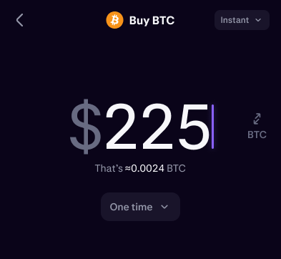
ALTERNATIVE / KRAKEN APP
B. The digital wallet purchase
KRAKEN APP / AMOUNT ENTRY
Tap Trade, then Buy.
Choose your cryptocurrency.
Enter an amount; select One time.
Open the payment selector.
Choose Apple Pay or Google Pay.
The wallet pays for the crypto purchase directly.
Kraken app / Amount entry example. Payment choice follows.
15 / 19
Notes:
Tap Trade, then Buy, choose the cryptocurrency and enter your amount. For a single purchase select One time. Open the available payment methods and choose Apple Pay or Google Pay. The screenshot is a crop of Kraken’s amount-entry illustration, showing the amount and frequency only. It does not depict a selected digital wallet. Check the wallet selection in your own account before moving to review.
Official sources checked 6 October 2026:
https://support.kraken.com/articles/360046777031-the-kraken-app
https://support.kraken.com/au/articles/4405883992724-digital-wallet-purchases

Slide 16
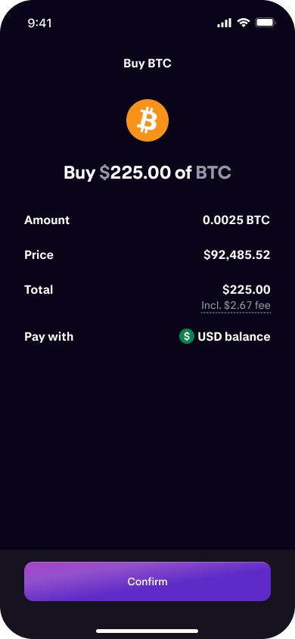
ALTERNATIVE / KRAKEN APP
C. The wallet approval
KRAKEN APP / PURCHASE REVIEW
Check quantity, price, fees and total.
Check Pay with shows your wallet.
Tap Confirm.
Approve using your device’s prompts.
Wait for purchase success.
Check Portfolio and keep your transaction record.
Kraken app / Review and Confirm. Wallet selection not pictured.
16 / 19
Notes:
Review the quote and verify that Pay with shows your selected Apple Pay or Google Pay wallet. Tap Confirm when ready and complete the device authorisation prompts. Wait for success and check Portfolio. These crops show only the review figures and Confirm control from Kraken’s support example; they do not depict a digital-wallet checkout or its device approval prompt.
Official sources checked 6 October 2026:
https://support.kraken.com/articles/360046777031-the-kraken-app
https://support.kraken.com/au/articles/4405883992724-digital-wallet-purchases

Slide 17
BEFORE YOUR NEXT MOVE
Fees and withdrawal timing
Compare the total cost before paying.
Banks may add conversion or card fees.
Some purchases can trigger a withdrawal
hold of up to 72 hours.
A withdrawal hold can delay a transfer to your own wallet.
17 / 19
Notes:
The checkout total is important, but your bank may add its own charges. Some instant purchases trigger a withdrawal hold of up to seventy-two hours. Check your account before planning an immediate transfer to a personal wallet. Other methods can have different hold periods.
Sources (checked 6 October 2026):
https://support.kraken.com/au/articles/4405883992724-digital-wallet-purchases
https://support.kraken.com/articles/360000389606-why-is-there-a-withdrawal-hold-on-my-account-
https://support.kraken.com/articles/360000381846-cash-deposit-options-fees-minimums-and-processing-times-

Slide 18
TROUBLESHOOTING
If something does not work
No wallet option? Check the Kraken app.
Payment declined? Ask your card issuer.
Deposit late? Check the expected timing.
Unclear result? Check history before retrying.
Use support.kraken.com for official help.
18 / 19
Notes:
If your bank declines the payment, ask the bank whether it permits crypto transactions. A digital wallet does not override a bank restriction. For a delayed deposit, check the stated processing time and reference. If a purchase result is unclear, inspect your balance and history before trying again.
Sources (checked 6 October 2026):
https://support.kraken.com/au/articles/4405883992724-digital-wallet-purchases
https://support.kraken.com/articles/360000381846-cash-deposit-options-fees-minimums-and-processing-times-

Slide 19
YOUR CRYPTO POCKETS
You now know the buying process
Bank route: deposit cash, then buy.
Wallet route: pay during the purchase.
Next lesson: moving crypto to your wallet.
Education only. Crypto prices can fall and you can lose money.
19 / 19
Notes:
You now know how the two routes work. Before any purchase, decide whether the asset and risk suit you. Our next lesson can cover withdrawing to a personal wallet, including networks, addresses and a small test transfer. This tutorial has no affiliate link.
Sources (checked 6 October 2026):
https://www.kraken.com/buy
https://support.kraken.com/articles/360049073651-how-do-i-deposit-my-local-currency-to-kraken-
https://support.kraken.com/au/articles/4405883992724-digital-wallet-purchases

